Slide 1
MOBILE APPLICATION DEVELOPMENT WITH ANDROID

Slide 2
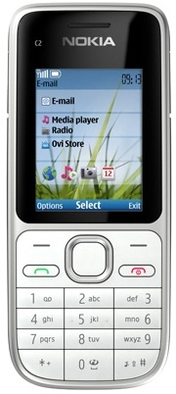
MOBILE AND SMARTPHONE APPLICATIONS
Mobile Phones:-
A mobile phone (also called mobile, cellular telephone, cell phone, or hand phone is an electronic device used to make
    Calls across a wide geographic area.
    Send Text SMS
    Can see call records
    Can capture image
    Can run music
    Can browse web etc.

Slide 3
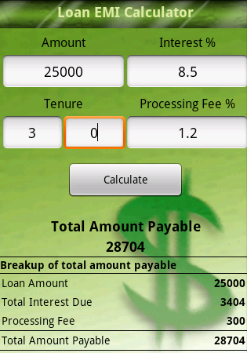
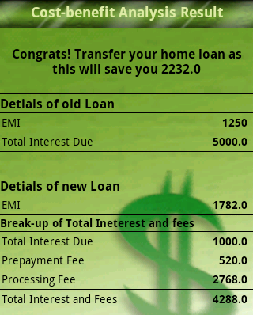
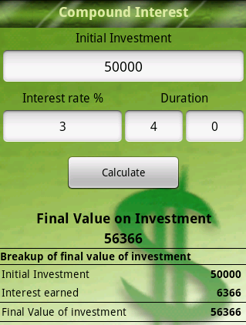
MOBILE AND SMARTPHONE APPLICATIONS
Mobile Phone Applications: Some Examples
Category: Utility Tools
Personal Finance Calculator
Another example can be: Daily Planner Application
Possible Features:
Task List
Reminder
Appointment etc.

Slide 4
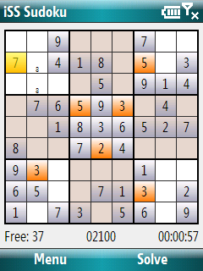

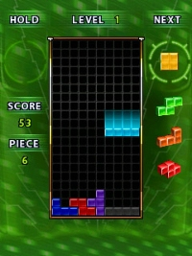
MOBILE AND SMARTPHONE APPLICATIONS
Mobile Phone Applications: Some Examples (Contd.)
Category: Games
Sudoku
Tetris
Snake

Slide 5

MOBILE AND SMARTPHONE APPLICATIONS
Different Mobile phone vendor companies use different platforms
  for developing applications for their own platform.
We’ll discuss about a open “Legacy” platform as an example which
  is J2ME
Java Platform, Micro Edition, or Java ME:
It is a Java platform designed for embedded systems (mobile
  Devices are one kind of such systems) .
Target devices range from industrial controls to mobile phones
  with Java (KVM support).
  Formerly known as Java 2 Platform, Micro Edition (J2ME).
  For details:
  http://en.wikipedia.org/wiki/Java_Platform,_Micro_Edition
Nokia, Samsung, Sony Ericsson and many other vendors supports
J2ME for applications and games development

Slide 6
MOBILE AND SMARTPHONE APPLICATIONS
Mobile Phone Applications: Development With J2ME
Limitations
Memory Issues
  Vendor Specific Implementation
  Insufficient Memory
  Inefficient Memory Management
Device Compatibility Issues
Not enough Access to Core System of the Phone
Vendor Specific Implementation of KVM

Slide 7
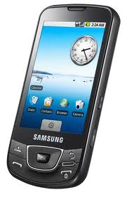
MOBILE AND SMARTPHONE APPLICATIONS
Smart Phones
A smartphone is a mobile phone that offers more advanced computing ability, Features and connectivity than a contemporary mobile phones.
Smart phones may be thought of as handheld computers integrated with a mobile telephone.
They also provide their own Operating System with Application Development Framework

Slide 8
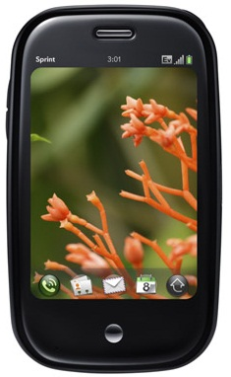
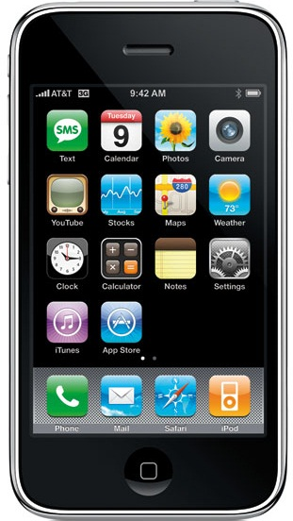
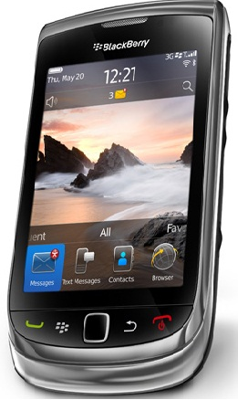
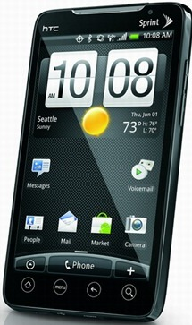
MOBILE AND SMARTPHONE APPLICATIONS
Smart Phones Platforms
Android
iPhone
BlackBerry
Palm Pre

Slide 9
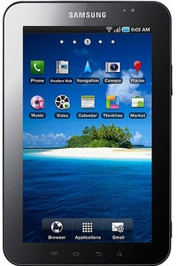
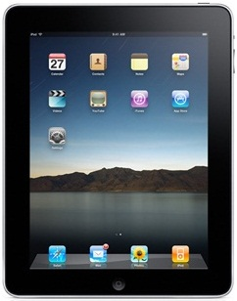
MOBILE AND SMARTPHONE APPLICATIONS
Tablet Platforms
Android: Galaxy Tab
Apple: iPad

Slide 10
OVERVIEW OF APPLICATION PLATFORMS
Platform | Language (s) | Remarks
Android | Java, C, C++ | Open Source OS (Based on Linux) http://developer.android.com
bada | C, C++ | Samsung’s mobile platform running on Linux or RealTime OS http://developer.bada.com
BlackBerry | Java, Web Apps | Java, Web Apps, Java ME compatible, extensions enable tighter integration http://na.blackberry.com/eng/developers
iOS | Objective-C, C | Requires Apple Developer Account http://developer.apple.com/iphone
MeeGo | Qt, C++, others | Intel and Nokia guided open source OS (based on Linux) http://meego.com/developers
Symbian | C, C++, Java, Qt, Web Apps, others | OS built from the ground up for mobile devices http://www.forum.nokia.com/symbian

Slide 11
OVERVIEW OF APPLICATION PLATFORMS
Platform | Language (s) | Remarks
webOS | HTML, CSS, JavaScript, C | Supports widget style programming (based on Linux) http://developer.palm.com
Windows Mobile | C#, C | .NET CF or Windows Mobile API, most devices ship with Java ME compatible JVM http://developer.windowsmobile.com
Windows Phone | C#, VB.NET | Silverlight, XNA Frameworks http://create.msdn.com

Slide 12
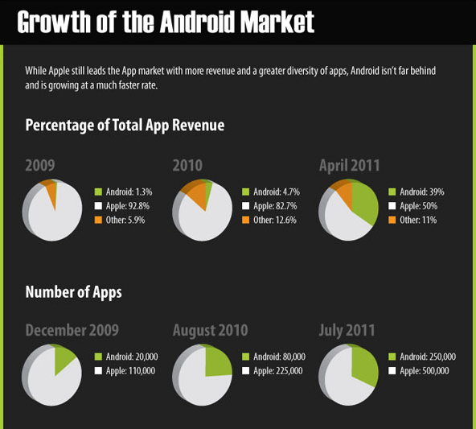
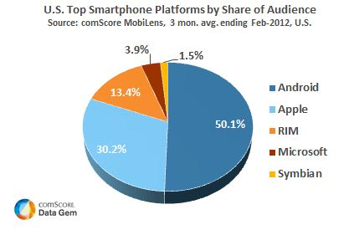
WHY ANDROID
Android Market Share

Slide 13
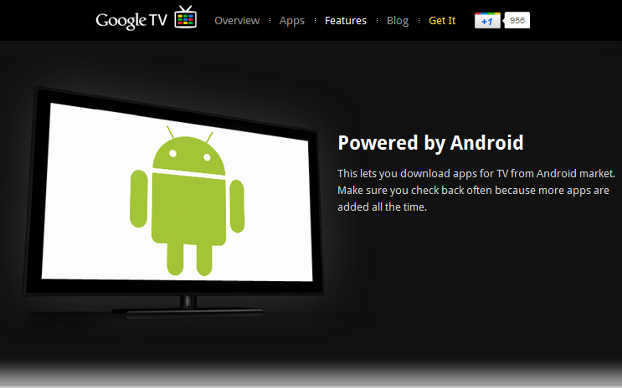
WHY ANDROID
Google TV

Slide 14











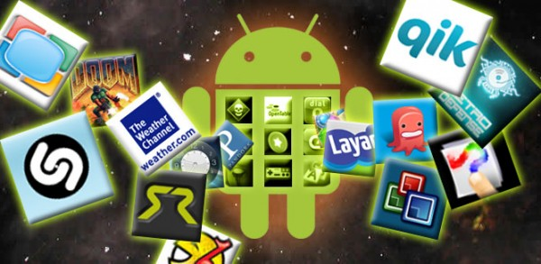



WHY ANDROID
Manufacturers: Designing the Android Handsets
Content Providers: Developing Apps
Mobile Operators
Markets: Distribution

Slide 15
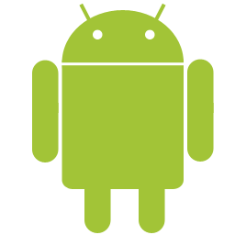
WHY ANDROID
Technical Advantages
No need to pay for any developer’s program to develop and test apps in real devices
Open source platform with scope of more innovation
(Less proprietary restrictions)
Java programming language
Rich and easy to integrate feature sets
Easy, effective and cost-effective prototyping for research and business
Development Environment Support in Windows, Mac & Linux (Ubuntu)

Slide 16
WHY ANDROID
Business Advantages
Android market:
  Integrated market app
  One time low registration fee
Many Distribution Channels:
  (We’ll see next)
Low Barrier to Market:
  No approval process
  Less restrictions with copyright issues

Slide 17
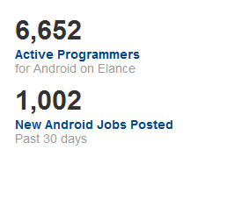
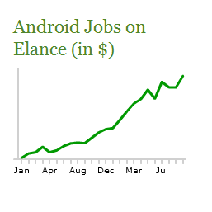
WHY ANDROID
Opportunities
Freelancing
Statistics
Source: http://www.elance.com/android-programmers-freelancers/230
Similar trend is seen in other freelancing sites
Can be a good source of income to support your own
product development or research

Slide 18

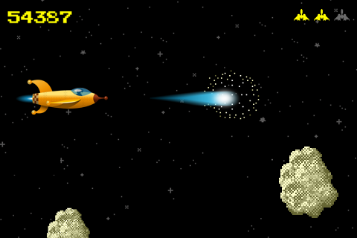
WHY ANDROID
Game Development Opportunities
Case Study: AhhhPah http://ahhhpah.com/
Development Time: 8 hours
Downloads: millions
Simplified Game frameworks
Libgdx: http://code.google.com/p/libgdx/
AndEngine: http://www.andengine.org/
Unity3d: http://unity3d.com/

Slide 19
WHY ANDROID
Research Opportunities

Slide 20

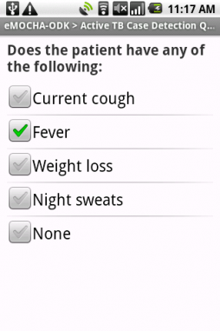
WHY ANDROID
Research Opportunities
Easy Prototyping of any idea is possible in Android. Some of the advanced research based projects are prototyped in Android.
mHealth
eMOCA (www.emocha.org)
Developed by the Johns Hopkins Center for Clinical Global Health Education,
eMOCHA uses video, audio, touchscreen quizzes, GPS and SMS to collect and analyze large amounts of data.

Slide 21
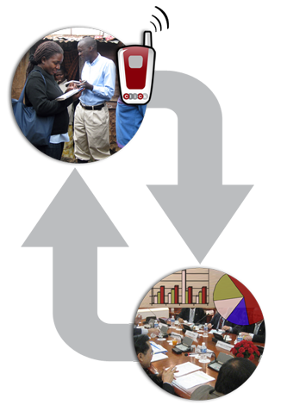
WHY ANDROID
Research Opportunities
Easy Prototyping of any idea is possible in Android. Some of the advanced research based projects are prototyped in Android.
mHealth
ClickDiagnostics
http://clickdiagnostics.com/
Developed by ClickDiagnostics,
uses video, audio, touchscreen
Quizzes to upload data to server to reach the consultants.

Slide 22
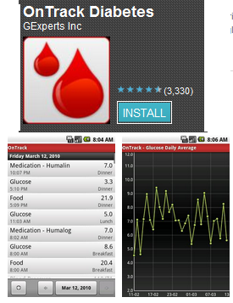
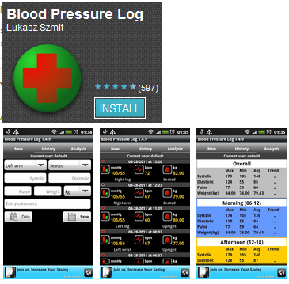
WHY ANDROID (CONT.)
Research Opportunities
mHealth
Clinical diagnosis + Data acquisition

Slide 23
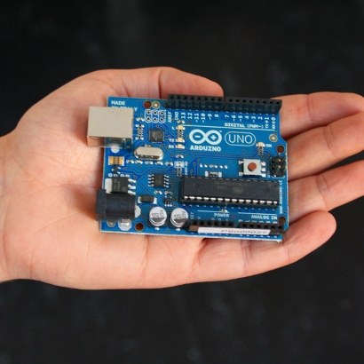
WHY ANDROID (CONT.)
Research Opportunities
Android + Arduino = Innovation Unlimited
Arduino (http://www.arduino.cc/)
Arduino is an open-source electronics prototyping platform
can sense the environment by receiving input from a variety of sensors and
can affect its surroundings by controlling lights, motors, and other actuators.
http://arduino.cc/blog/2011/10/12/android-open-2011-massimo-banzi-arduino-android-infinite-possibilities/

Slide 24
WHY ANDROID
Research Opportunities
Android in Disaster Management
A Mobile Disaster Management System Using the Android Technology
http://www.naun.org/journals/communications/19-280.pdf
Implementation of an Android based disaster management system
http://www.bcdph.com/download/android.pdf

Slide 25
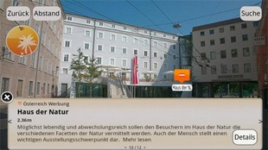
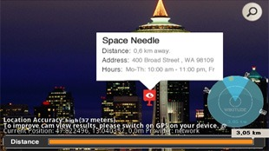
WHY ANDROID
Application Development Opportunities
Augmented Reality
Some more: http://techsplurge.com/3214/mega-list-33-awesome-augmented-reality-apps-games-android/
Real World Environment+ Sound, Video, Graphics data generated by systems= AR

Slide 26
ANDROID HISTORY
OHA(Open Handset Alliance) is a group of 71 technology and mobile companies, including Google, Intel, Dell, HTC and China Mobile…
OHA’s aim：
  accelerate innovation in mobile phones
  offer consumers a richer, less expensive, and better mobile experience
OHA developed Android™, the first complete, open, and free mobile platform
OHA was initially called up by Google, and Google is the ‘captain’

Slide 27
WHAT IS ANDROID
Android is a software stack for mobile devices that includes an operating system, middleware and key applications. The Android SDK provides the tools and APIs necessary to begin developing applications on the Android platform using the Java programming language.
Google describes Android as:
The first truly open and comprehensive platform for mobile devices, all of the software to run a mobile phone but without the proprietary obstacles that have hindered mobile innovation.

Slide 28
WHAT IS ANDROID
Android is based on JAVA and all its applications are developed in JAVA
The JAVA VM, known as Dalvik, is highly customized and optimized for mobile devices
Android SDK offers rich tools for android
application development and many useful APIs。

Slide 29
ANDROID FEATURES
Application framework enabling reuse and replacement of components
Optimized Java virtual machine: Dalvik
Optimized Graphics Processing, supporting 2D and 3D graphics(OpenGL ES 1.0 )
Integrated open source web browser: WebKit
SQLite for structured data storage

Slide 30

ANDROID FEATURES
Multimedia capability, supporting varieties of audio, video and still image formats
GSM Telephony
bluetooth , EDGE, 3G and Wi-Fi support
Camera, GPS, compass, accelerometer
and other sensors support
Rich development environment, including an emulator, debugging tools, memory probe tools, log tools and powerful eclipse plugins
Hardware dependent

Slide 31

ANDROID ARCHITECTURE

Slide 32
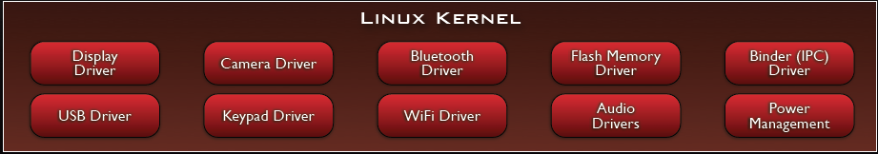
ANDROID ARCHITECTURE
Linux Kernel:-
  Note that Android based on a Linux kernel not a Linux OS
  Supplies Security, Memory management, Process management, Network stack and Driver model
  Acts as an abstraction layer between the hardware and the rest of the software stack

Slide 33
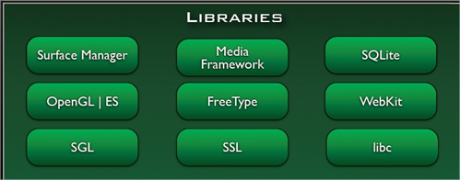
ANDROID ARCHITECTURE
Libraries:-
Run in system background
Using C/C + + Language
4 types of Libraries
  Bionic Libc, system C libraries
  Function Libraries, supporting multimedia, web browser, SQLite...
  Native Servers
  Hardware
  Abstraction Libraries

Slide 34
ANDROID ARCHITECTURE
Core Libraries:-
System C library, the standard C system library, tuned for embedded Linux-based devices
Media Libraries, support playback and recording of many popular audio and video formats, as well as image files, including MPEG4, H.264, MP3, AAC, AMR, JPG, and PNG
Surface Manager, manages access to the display subsystem and seamlessly composites 2D and 3D graphic layers from multiple applications
WebKit, a modern web browser engine which powers both the Android browser and an embeddable web view
SG L, the underlying 2D graphics engine
3 D libraries, an implementation based on OpenGL ES 1.0 APIs
Free Type , bitmap and vector font rendering
SQLite , a powerful and lightweight relational database engine

Slide 35
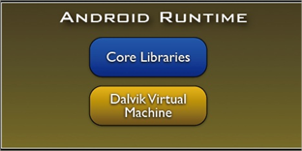
ANDROID ARCHITECTURE
Android Runtime:-
The core of Android platform
Dalvik Virtual Machine
  Register-based
  Executes files in the Dalvik
  Executable (.dex) format
Java core Libraries
  Provides most of the functionality of the Java programming language.

Slide 36
ANDROID ARCHITECTURE
Android Runtime:-
The functions of Java core libraries rely on the Dalvik VM and the underlying Linux kernel
Multiple Dalvik VMs may run at the same time
Every Android application runs in its own process, with its own instance of the Dalvik virtual machine
  The "dx" tool in Android SDK can transform compiled JAVA class into the .dex format

Slide 37
ANDROID ARCHITECTURE
Dalvik Virtual Machine:-
Android custom implementation virtual machine
  Provides application portability and runtime consistency
  Runs optimized file format (.dex) and Dalvik bytecode
  Java .class / .jar files converted to .dex at build time
Designed for embedded environment
  Supports multiple virtual machine processes per device
  Highly CPU-optimized bytecode interpreter
  Efficiently Using runtime memory
Core Libraries
  Core APIs for Java language provide a powerful, yet simple and familiar development platform

Slide 38
ANDROID ARCHITECTURE
DVM vs. JVM:-
DVM
  Google
  Dalvik executable
  Only supports a subset of standard Java Library
JVM
  Sun
  Java bytecode
Some worries that Java world may be divided into different communities, each has its own Java standard

Slide 39
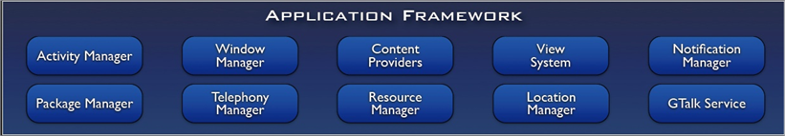
ANDROID ARCHITECTURE
Application Framework:
Simplify the reuse of components
  Applications can publish their capabilities and any other application may then make use of those capabilities
Applications is a set of services and systems, include
  Views system, content providers, resources manager and so on

Slide 40
ANDROID ARCHITECTURE
Application Framework:-
Activity Manager, manages the lifecycle of applications and provides a common navigation back stack
Notification Manager, enables all applications to display custom alerts in the status bar
Resource Manager, providing access to non-code resources such as localized strings, graphics, and layout files
Content Providers, access data from other applications (such as Contacts), or to share their own data
Views, used to build an application, including lists, grids, text boxes, buttons, and even an embeddable web browser

Slide 41
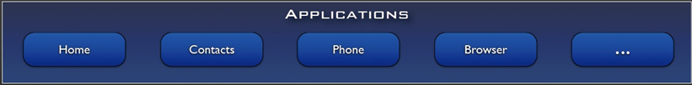
ANDROID ARCHITECTURE
Applications:-
A set of core applications shipped with Android platform
  an email client, SMS program, calendar, maps, browser, contacts, and others
All written in Java
Our applications are in the same level as these applications

